Slide 1
Shear viscosity of a highly excited string and black hole membrane paradigm
Yuya Sasai
Helsinki Institute of Physics and Department of Physics University of Helsinki
in collaboration with A. Zahabi
Based on arXiv:1010.5380
Accepted by PRD
Short talk at RIKEN
17 December 2010

Slide 2
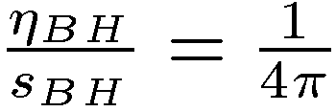
Mysteries of black holes
Microscopic origin of Bekenstein-Hawking entropy
(A: area of the event horizon)
Microscopic origin of membrane paradigm
“A certain fictitious viscous membrane seems to be sitting on a stretched horizon for a distant observer.”
Thorne, Price, Macdonald (1986)
BH
Stretched horizon
We need a consistent quantum theory which includes gravity.
String theory!

Slide 3
Entropy of a macroscopic black hole from a fundamental string
Susskind (1993)
A large gravitational redshift of a black hole explains the difference between and .
Consider a highly excited string on a stretched horizon
of a Schwarzshild black hole.
Due to the redshift, the energy for an observer at the stretched horizon is not the same as the energy for an asymptotic observer.
BH

Slide 4
Membrane paradigm from the viewpoint of a fundamental string
Can we reproduce the viscosity of the
fictitious membrane from a highly excited
string?
BH
What is the viscosity of the string?
In polymer physics,
This is due to the fact that the stress tensor
of the polymer itself is added to the stress
tensor of the solvent.

Slide 5
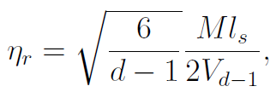
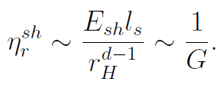
Shear viscosity of the longitudinally reduced string on the
stretched horizon
Shear viscosity of the longitudinally reduced
string in the flat background
BH
On the stretched horizon, we have to replace
,
This is consistent with
the membrane paradigm

Slide 6
Summary
We have obtained the shear viscosity and
of the
highly excited string by using the Kubo’s formula.
We have estimated the shear viscosity and
of the string on the stretched horizon of the black hole.
The results are consistent with the black hole membrane
paradigm.

