Slide 1
強磁場原始中性子星での
ニュートリノ反応断面積の非対称性と関連現象
Tomoyuki MARUYAMA BRS, Nihon Univ. (Japan)\
共同研究者
日高 潤 国立天文台
黒田 仰生 国立天文台
滝脇 知也 国立天文台
梶野 敏貴 国立天文台
安武 伸俊 千葉工大
C.Y. Ryu 漢陽大学 (韓国）
千 明起 崇實大学 （韓国）
G.J. MATHEWS Univ. of Notre Dome (USA)
1

Slide 2
§1 Introduction
2
High Density Matter Study ⇒ Exotic Phases inside Neutron Stars
Strange Matter, Ferromagnetism, Meson Condensation, Quark matter
Observable Information ‥‥Neutrino Emissions
S.Reddy, et al., PRD58 #013009 (1998) Influence from Hyperons Λ，∑
Magnetar 10¹⁵G in surface 10¹⁷⁻¹⁹G inside (?) → Large Asymmetry of ν？
Our Works : Neutrino Scatt. and Absorp. under Strong Magnetic Field
TM et al., PRD83, 081303(R) (11), PRD86,123003 (12)
Neutrinos are More Scattered and Less Absorbed
in Direction Parallel to Magnetic Field
⇒ More Neutrinos are Emitted in Arctic Area
Scattering 1.7 %
Absorption 2.2 % at ρ_{B}=3ρ₀ and T = 20 MeV

Slide 3
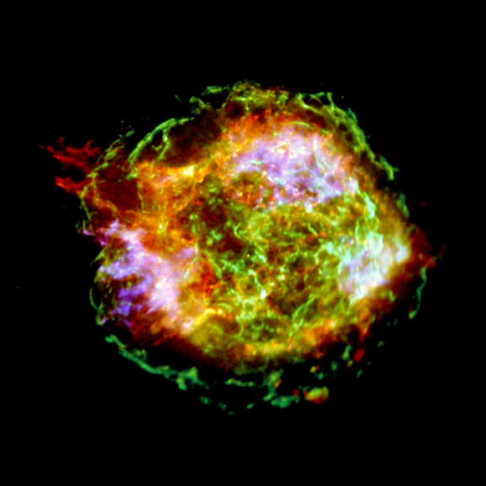
CasA
Asymmetry of Supernova Explosion
kick and translate Pulsar with
Kick Velocity: Average … 400km/s，
Highest … 1500km/s
A.G.Lyne, D.R.Lomier, Nature 369, 127 (94)
Explosion Energy ~ 10⁵³ erg
(almost Neutrino Emissions)
1% Asymmetry is sufficient
to explain the Pulsar Kick
D.Lai & Y.Z.Qian, Astrophys.J. 495 (1998) L103
Our Works TM et al., PRD86,123003 (12)
B = 2× 10¹⁷G Poloidal Configuration of Magnetic Field
V_{kick} = 580 km/s ( p,n ) , 610 km/s (p,n,Λ） at T = 20 MeV
Antarctic Direction
http://chandra.harvard.edu/photo/
2004/casa/casa_xray.jpg
3

Slide 4
Stability of Magnetic Field in Compact Objects
(Braithwaite & Spruit 2004)
Toroidal Magnetic Field is stable !!
4

Slide 5
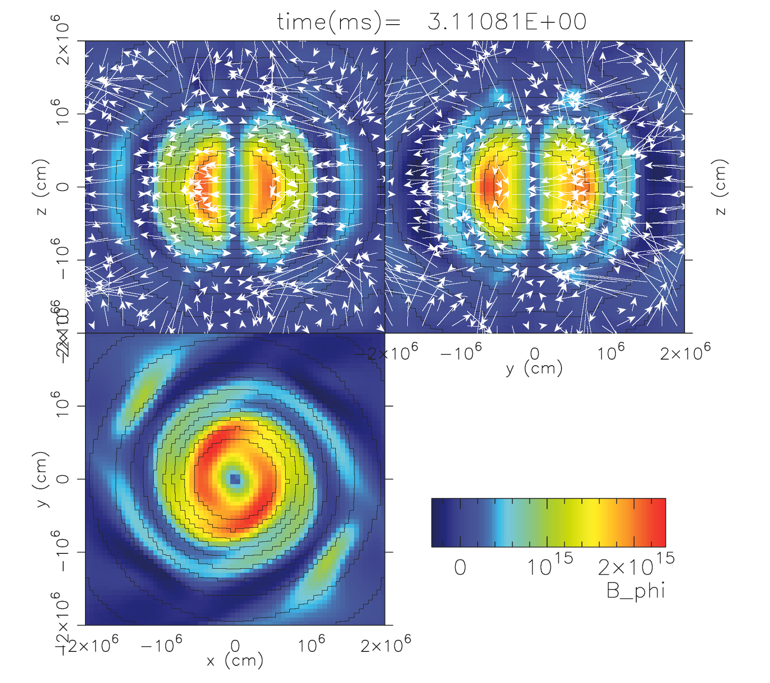
T.Kuroda and H. Umeda, Astro. J. Suppl. 191, 439 (10)
Single Toroidal

Slide 6
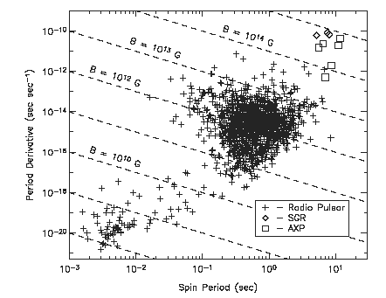
Magnetar Spin Period
2 ～ 12 s （Very Long)
Large Spin-down is necessary
in Process of NS production
Magnetic Field Confguration in PNS
Poloidal (10¹⁴G) + Toroidal (10¹⁶G) Magnetic Field
T. Takiwaki, K.Katake and K. Sato Astro. J 691, 1360 (2009)
Antisymmetric ν －Emission in Toloidal Configuration
⇒ Rapid Spin Deceleration

Slide 7

§2. Formulation
Magnetic Field :
Baryon
Lepton
B & L – Mag.
Proto-Nuetron-Star (PNS) Matter without Mag. Field
Baryon Wave Function under Mag. Field in Perturbative Way
Cross-Sections for ν reactions
Weak Interaction
ν_{e} + B → ν_{e} + B : scattering
ν_{e} + B → e⁻ + B’ : absorption
S.Reddy, M.Prakash and J.M. Lattimer, P.R.D58 #013009 (1998)

Slide 8
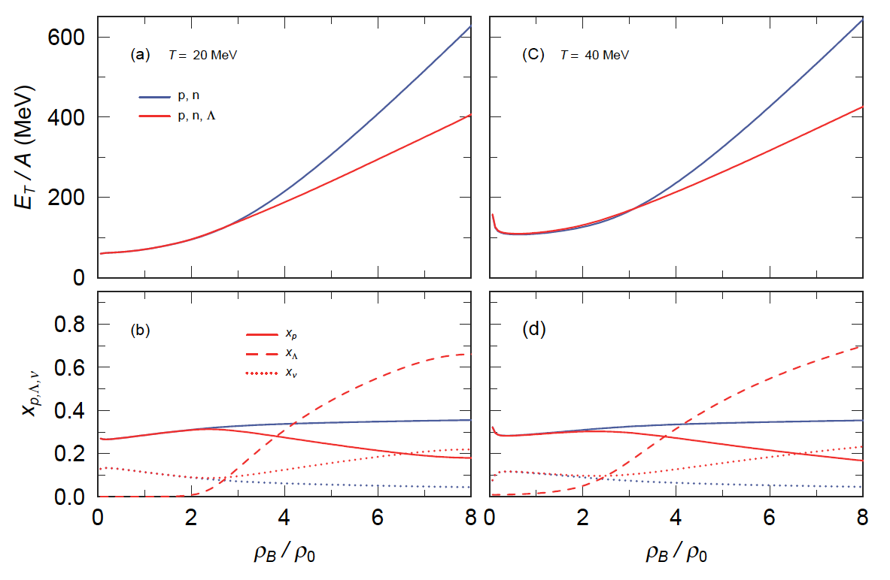
§2-1 EOS of Proto Neutron-Star-Matter in RMF
N, Λ, σ, ω, ρ
8
PM1-L1
SU(3)
T.M, et al.
PTP. 102, p809 (1999)
Charge Neutral （ ） & Lepton Fraction : Y_{L} = 0.4

Slide 9


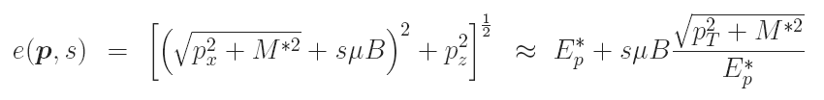

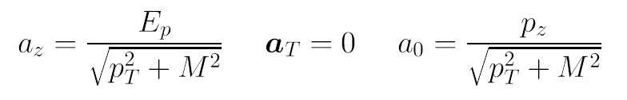
§2-2 Dirac Equation under Magnetic Fields
μ_{N} B << ε_{N} (Chem. Pot) → B can be treated perturbatively
Landau Level can be ignored
B ~ 10¹⁷ G
Lagrangian
Dirac Eq.
Single Part. Eng.
Dirac Spinor
Spin Vector

Slide 10
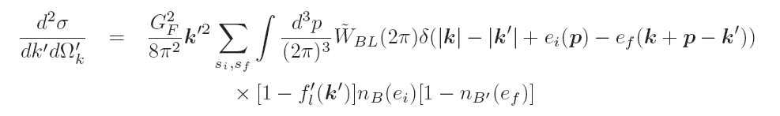
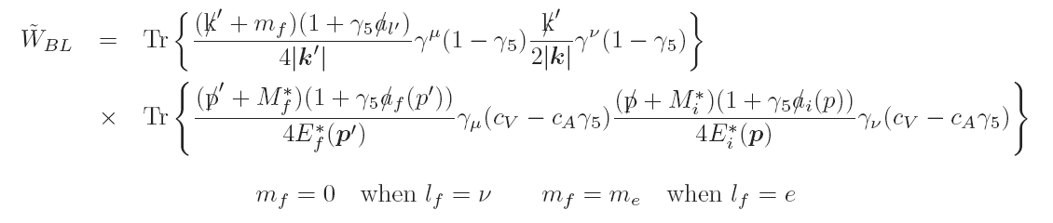

The Cross-Section of Lepton-Baryon Scattering
Fermi
Distribution
Deformed Distribution
Perturbative
Treatment
Non-Magnetic Part
Magnetic Part

Slide 11
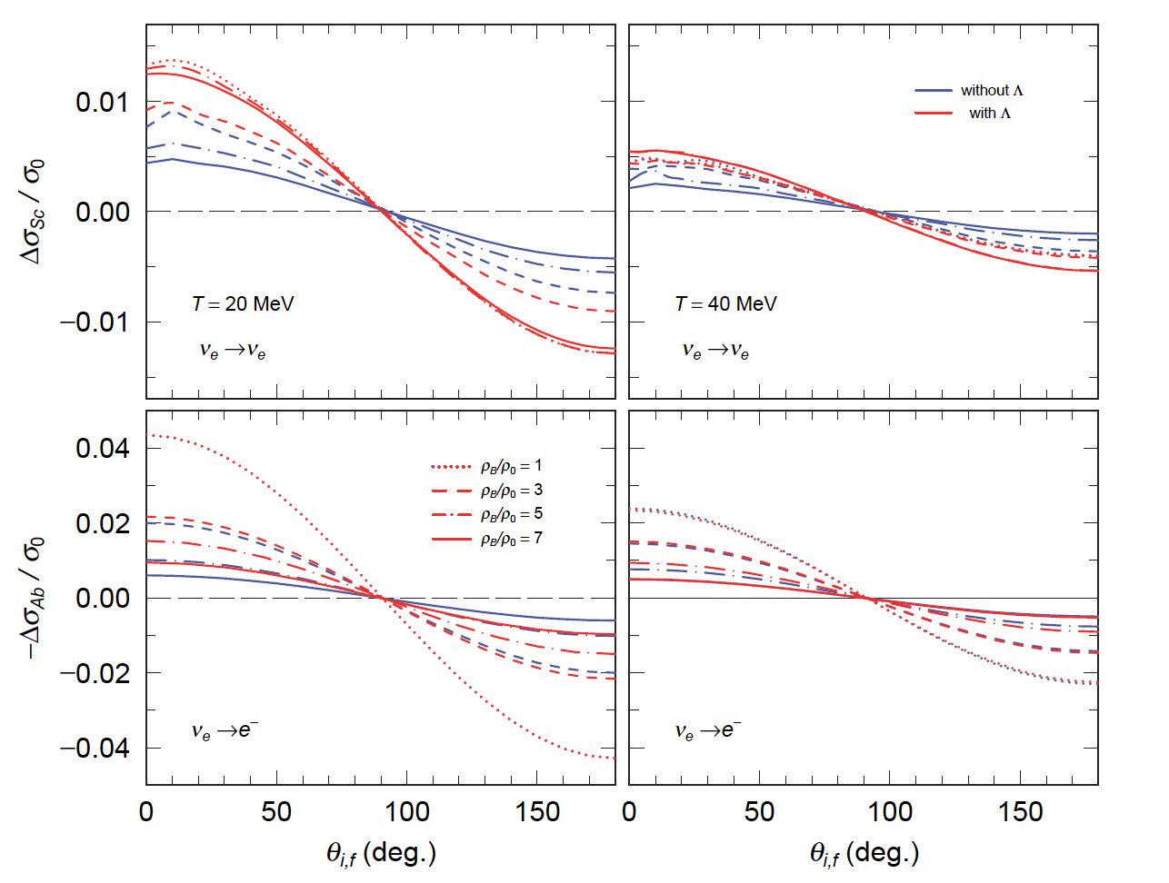
§2-3 Magnetic parts of Cross-Sections
Scat.
Integrating over the initial angle
Increasing ν
in Dir. parallel to B
Absorp.
Integrating over the final angle
11

Slide 12
§3 Neutrino Transportation
Neutrino Phase Space Distribution Function
Equib. Part
Non-Equib. Part
Neutrino Propagation ⇒ Boltzmann Eq.
Neutrinos Propagate on Strait Line
only absorption
Solution ⇒

Slide 13
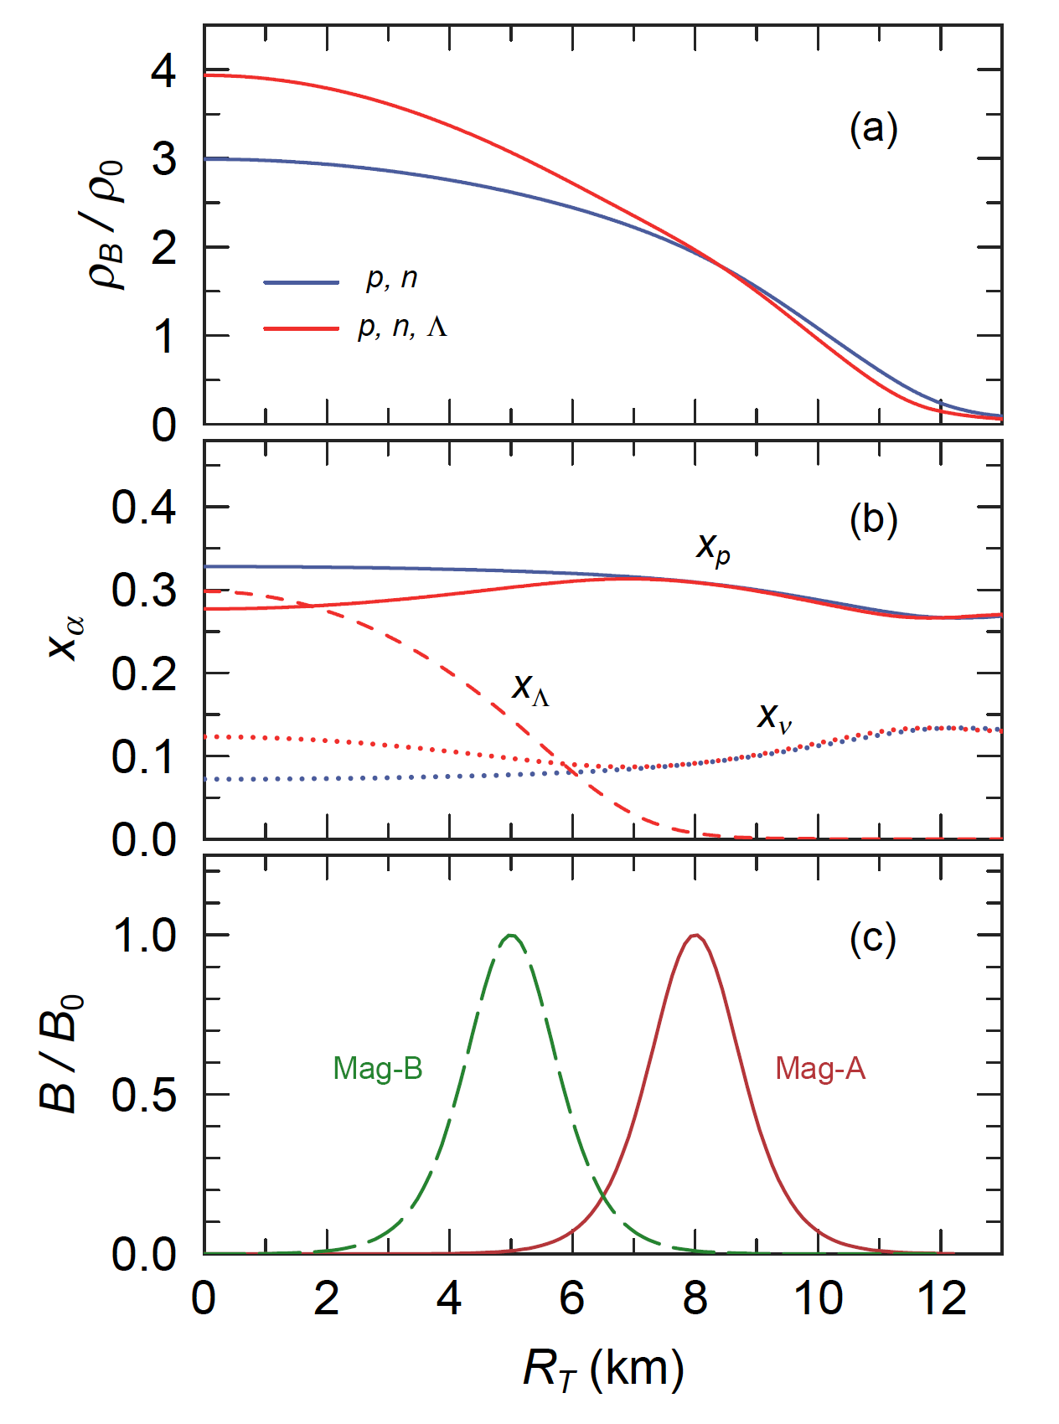
Toroidal Magnetic
Field
T = 20MeV
Δr = 0.5 (km)
R₀ = 8 (km) (Mag-A)
R₀ = 5 (km) (Mag-B)
z = 0

Slide 14
Neutrino Luminosity
(dE_{T}/dt)_{ν} ~ 3×10⁵² erg/s
§5 Spin Deceleration
Period P = 10ms
Magnetic
Dipole Rad.
Mag Distr. | Bary. | (cm)
 |  |  | (ν emis.) |  | MDR
 |  |  | ρ_{s} = ρ_{０} | ρ_{s} = ρ_{０} /10
p,n | Mag-A | 3.34 | 3.45×10^{－6} | 7.25×10^{－7} | 9.86×10^{－8}
 | Mag-B |  | 4.97×10^{－7} | 3.16×10^{－7}
p,n,Λ | Mag-A | 5.45 | 6.39×10^{－6} | 1.02×10^{－6} | 7.76×10^{－8}
 | Mag-B |  | 4.57×10^{－7} | 2.01×10^{－7}
In Early Stage (～ 10 s) ν Asymmetric Emission must affect PNS Spin
More Significantly than Magnetic Dipole γ-Radiation
14

Slide 15
Present PNS Model
Uniform Matter, Iso-Thermal, Fixed Lepton Fraction
Strong Magnetic Field
Available in Inside Region
Surface Region
Past Structure, Low Temperature, Small Neutrino Fraction
Rather Weak magnetic Field
Larger Mean Free Path of Neutrino
We need to stop calculation at a Certain Radius
R_{C}, where ρ_{B} = ρ_{c}

Slide 16
§4 Summary
Asymmetry of Neutrino Absorption
4.3 % at ρ_{B}=ρ_{0,} 2.2 % at ρ_{B}=3ρ₀ when T = 20 MeV and B = 10¹⁷G
Estimating Spin-Down Rate of PNS with Toroidal Magnetic Field Configuration
Mag. Field Poloidal 10¹⁴G, Toroidal Max: 10¹⁶G
Asymmetry of Neutrino Absorption
4.3 % at ρ_{B}=ρ_{0,} 2.2 % at ρ_{B}=3ρ₀ when T = 20 MeV and B = 10¹⁷G
Spin-Down Ratio P-dot/P = 10⁻⁶ ～ 10⁻⁷ (1/s) for Asym. ν –Emit
≈ 10⁻⁷ (1/s) for MDR
16

Slide 17
Future Plans
Other Effects: ν-Scattering & ν-Production
Iso-Temp. ⇒ Iso-Entropy
Exact Solution of Dirac Eq. in Non-Perturbative Cal.
→ Landau Level at least for Electron
Neutrino Propagation in Low Density
e‐ + p → ν _{e} + n
Appling Our Method to Double Toroidal Configuration
Making Data Table and
Applying it to Supernovae Simulations

Slide 18
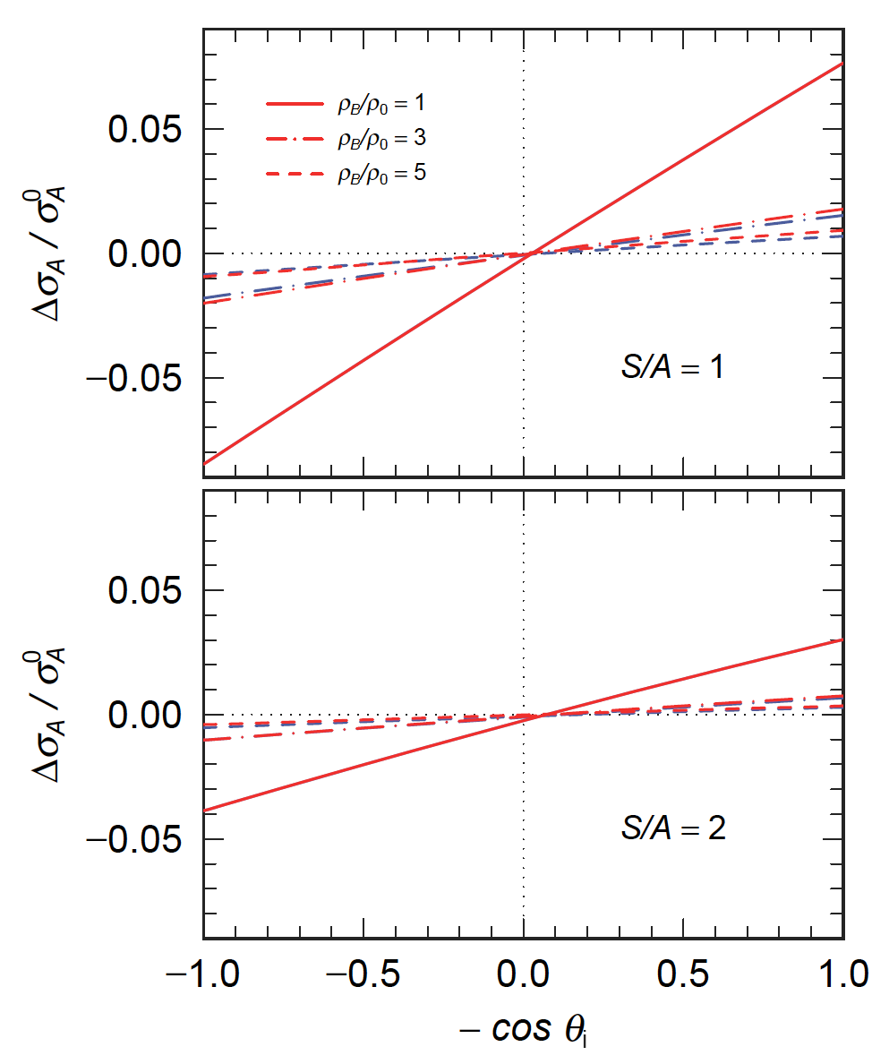
Magnetic parts of Absorption Cross-Sections
Integrating over the final angle
Less Absorption
&
Increasing ν
in Dir. parallel to B
18

Slide 19
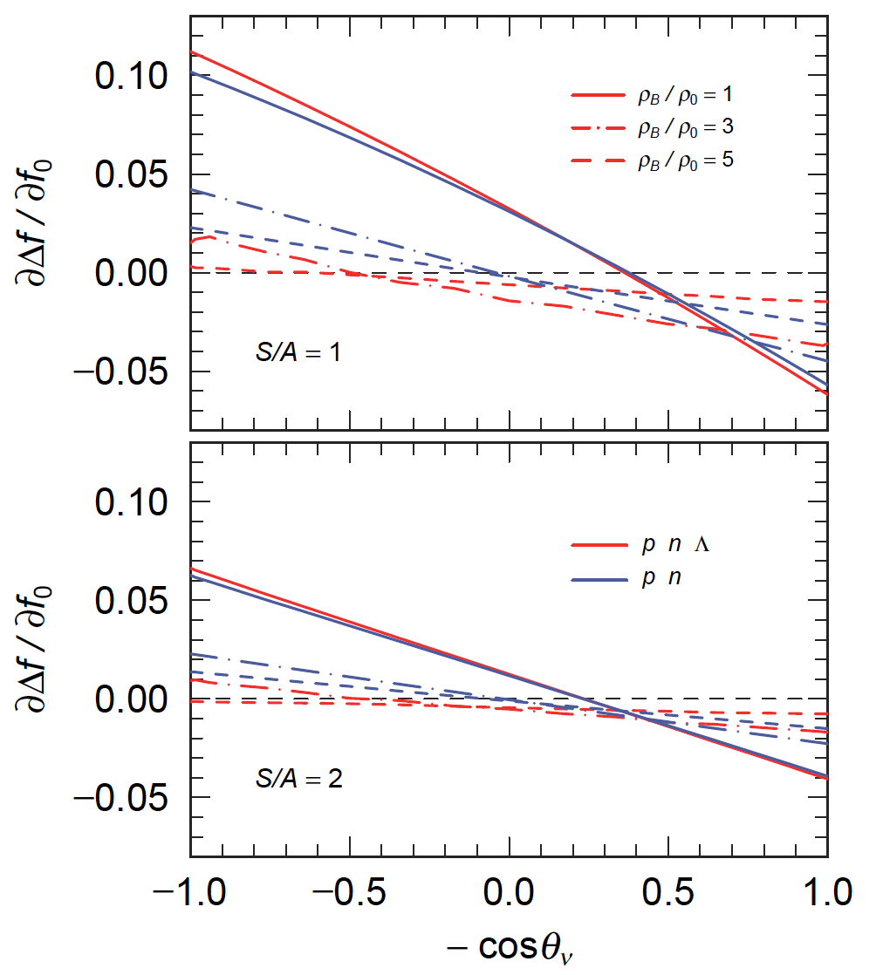
Magnetic parts of Neutrino Production
e⁻ + B → ν_{e} + B’ (DU)

