Slide 1
Shear viscosity of a highly excited string and black hole membrane paradigm
Yuya Sasai
Helsinki Institute of Physics and Department of Physics University of Helsinki
in collaboration with A. Zahabi
Based on arXiv:1010.5380
Accepted by PRD
RIKEN symposium 2010
18 December 2010

Slide 2
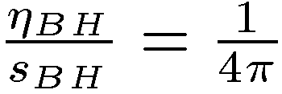
1. Introduction
Mysteries of black holes
Microscopic origin of Bekenstein-Hawking entropy
(A: area of the event horizon)
Microscopic origin of membrane paradigm
“A certain fictitious viscous membrane seems to be sitting on a stretched horizon for a distant observer.”
Thorne, Price, Macdonald (1986)
BH
Stretched horizon
We need a consistent quantum theory which includes gravity.
String theory!

Slide 3
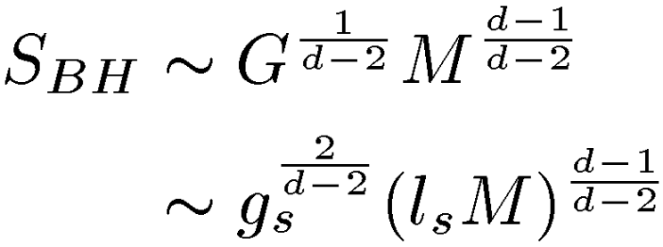
Bekenstein-Hawking entropy vs entropy of a fundamental string
Entropy of a fundamental string
Logarithm of the number of degeneracy of the string states
For a highly excited free string,
On the other hand,
(d: Number of spatial dimensions)
Clearly, in generic

Slide 4
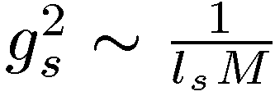
String-black hole correspondence
Horowitz, Polchinski (1996)
Damour, Veneziano (1999)
If
,
!
At this point, the horizon radius becomes
If we increase adiabatically, a highly excited string becomes
a black hole with at .
=

Slide 5
Entropy of a macroscopic black hole from a fundamental string
Susskind (1993)
A large gravitational redshift of a black hole explains the difference between and .
Consider a highly excited string on a stretched horizon
of a Schwarzshild black hole.
Due to the redshift, the energy for an observer at the stretched horizon is not the same as the energy for an asymptotic observer.
BH

Slide 6
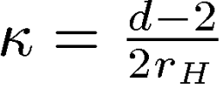
Derivation of
Susskind (1993)
(d+1)-dimensional Schwarzshild metric
: Volume of a unit (d-1) sphere
Near horizon geometry
2 dim. Rindler spacetime
: Surface gravity

Slide 7
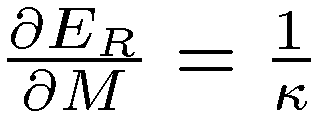
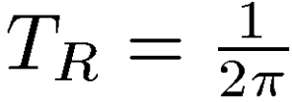
To find the energy and temperature for an observer at ,
it is convenient to introduce dimensionless Rindler quantities.
Define the Rindler time
Rindler energy is conjugate to
is conjugate to
Thus,
By using the first law of thermodynamics, we obtain the
Rindler temperature

Slide 8
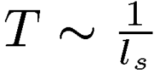
The proper time at is
The stretched horizon is defined by the place where the local Unruh temperature is given by the Hagedorn temperature
The stretched horizon is located at
.

Slide 9
Consistency with the string-black hole correspondence
If the redshift factor is of the order of one,
This is the same situation as the string-black hole correspondence.
In this case, the energy and temperature for an observer
on the stretched horizon are of the same order as those
for the asymptotic observer.

Slide 10
Membrane paradigm from the viewpoint of a fundamental string
Can we reproduce the viscosity of the
fictitious membrane from a highly excited
string?
BH
What is the viscosity of the string?
In polymer physics,
This is due to the fact that the stress tensor
of the polymer itself is added to the stress
tensor of the solvent.

Slide 11
Contents
1. Introduction
2. Open string in highly excited states
3. Shear viscosity of a highly excited string
4. Shear viscosity of a string on a stretched horizon and
black hole membrane paradigm
5. Summary and comments

Slide 12
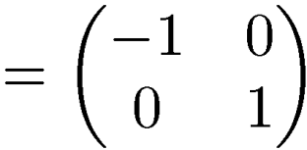
2. Open string in highly excited states
Review of bosonic open string
Worldsheet action in flat background spacetime
Choosing the unit gauge,
,
the action becomes
where
.

Slide 13
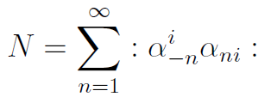
Mode expansion of for open string
where
.
We choose the light-cone gauge,
Mass shell condition
where
( )

Slide 14
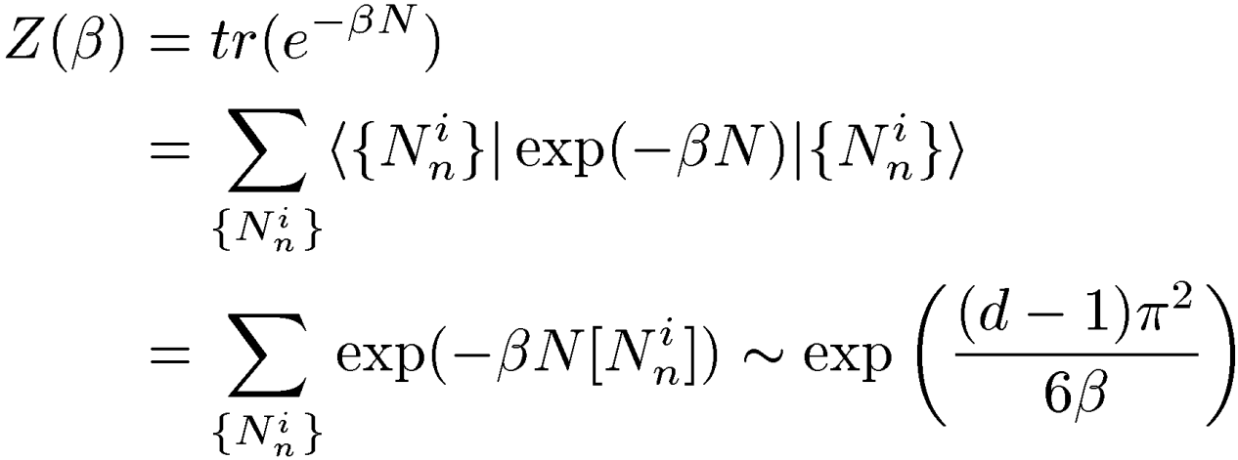
Observables in highly excited string states
Damour, Veneziano (1999)
In terms of the usual harmonic oscillators,
The level of the open string becomes
Number operator
Consider the following “canonical partition function”,

Slide 15
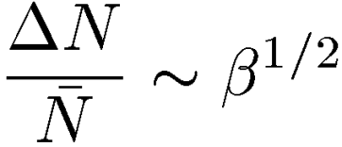
Since the density matrix is defined by
,
an expectation value of an observable is evaluated by
( : Observable)
The mean value of the level and the fluctuation
If , we can obtain observables in
highly excited string states.

Slide 16
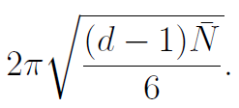
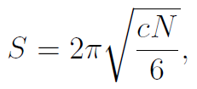
Mass of the string
Entropy of the string
This is consistent with the Cardy formula,
(c : central charge)
with

Slide 17
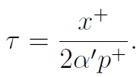
3. Shear viscosity of a highly excited string
Stress tensor of the open string
Source term
After Insertion of the light-cone gauge and integration over ,
with

Slide 18
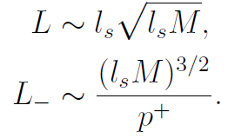
Since the stress tensor trivially vanishes
outside the string sizes, we restrict the
ranges of the spatial coordinates as follows:
where we have chosen
.
For free open string,

Slide 19
To obtain the viscosity, we just have to consider the long wave
length limit.
Zero modes for spatial directions
Fourier expansions of the delta functions
Zero mode of the stress tensor
where

Slide 20
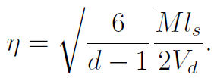
Kubo’s formula for shear viscosity
(We have assumed that nonvanishing components of the metric
perturbation are and they only depend on .)
Using
,
We obtain

Slide 21
4. Shear viscosity of a string on a stretched horizon and
black hole membrane paradigm
Difference between fictitious membrane and highly excited string
Membrane paradigm
Highly excited string
BH
Distributed
in spatial
dimensions
dimensional
surface
No radial thickness.
Mass dimension
of stress tensor
Mass dimension
of shear viscosity
We consider the longitudinally reduced
stress tensor of the string.

Slide 22
Longitudinally reduced stress tensor
The stress tensor of the string can be written as
.
We define the longitudinally reduced stress tensor
(Mass dimension = d)
The zero mode of for the transverse directions

Slide 23
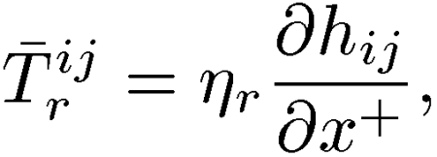
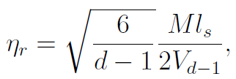
Shear viscosity of the longitudinally reduced string
Since
the shear viscosity of the longitudinally reduced string is
where
is the volume of the transverse size of the string.
does not change if the string is longitudinally reduced
because this quantity is dimensionless.

Slide 24
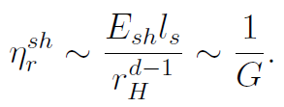
Shear viscosity of the longitudinally reduced string on the
stretched horizon
Shear viscosity of the longitudinally reduced
string in the flat background
BH
On the stretched horizon, we have to replace
,
This is consistent with
the membrane paradigm

Slide 25
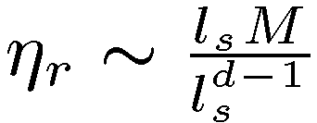
Consistency with string-black hole correspondence
If
, a highly excited string becomes a black hole
with .
At the critical string coupling, the shear viscosity of the string will be
On the other hand, the shear viscosity in the membrane paradigm
becomes
Consistent!

Slide 26
About the ratio of the shear viscosity to entropy density
In our estimate,
does not change even if we put the string
on the stretched horizon.
On the other hand,
If
,
of the string matches with that of the membrane paradigm.

Slide 27
5. Summary and comments
We have obtained the shear viscosity and
of the
highly excited string by using the Kubo’s formula.
We have estimated the shear viscosity and
of the string on the stretched horizon of the black hole.
The results are consistent with the black hole membrane
paradigm.

Slide 28
We have not considered the self-interactions of the highly excited
string. This will lead to the corrections to shear viscosity.
It is important to investigate whether the correct numerical
coefficient of the shear viscosity in the membrane paradigm
can be derived from superstring theory.
We have not discussed the bulk viscosity because we could not
reproduce the negative bulk viscosity of the membrane paradigm
from the highly excited string on the stretched horizon.
It is interesting to find transport coefficients of a highly excited
string when source fields are given by other fields instead of metric.

